Slide 1
SBE Introduction

Slide 2
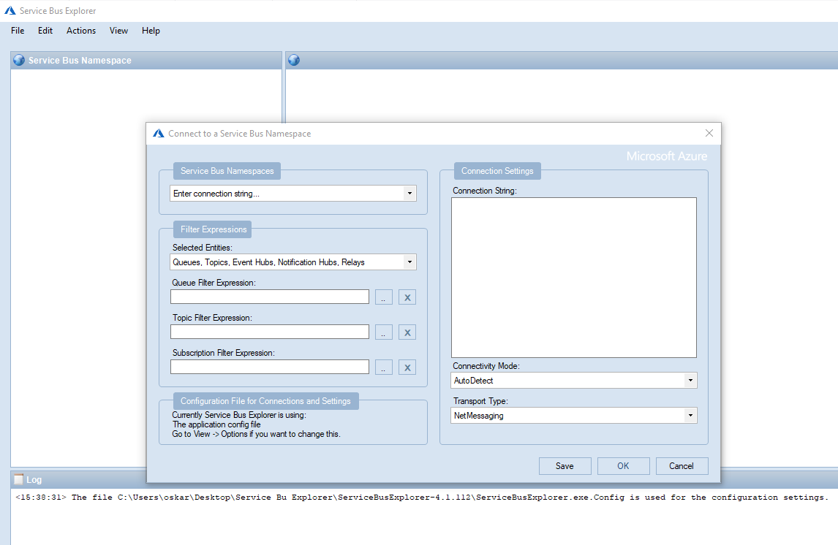
Once you have downloaded Paolos Service Bus Explorer fromhis github, start ServiceBusExplorer.exe, press file in the top right and press connect. In the drop down menu at the top, select enter connection string.

Slide 3
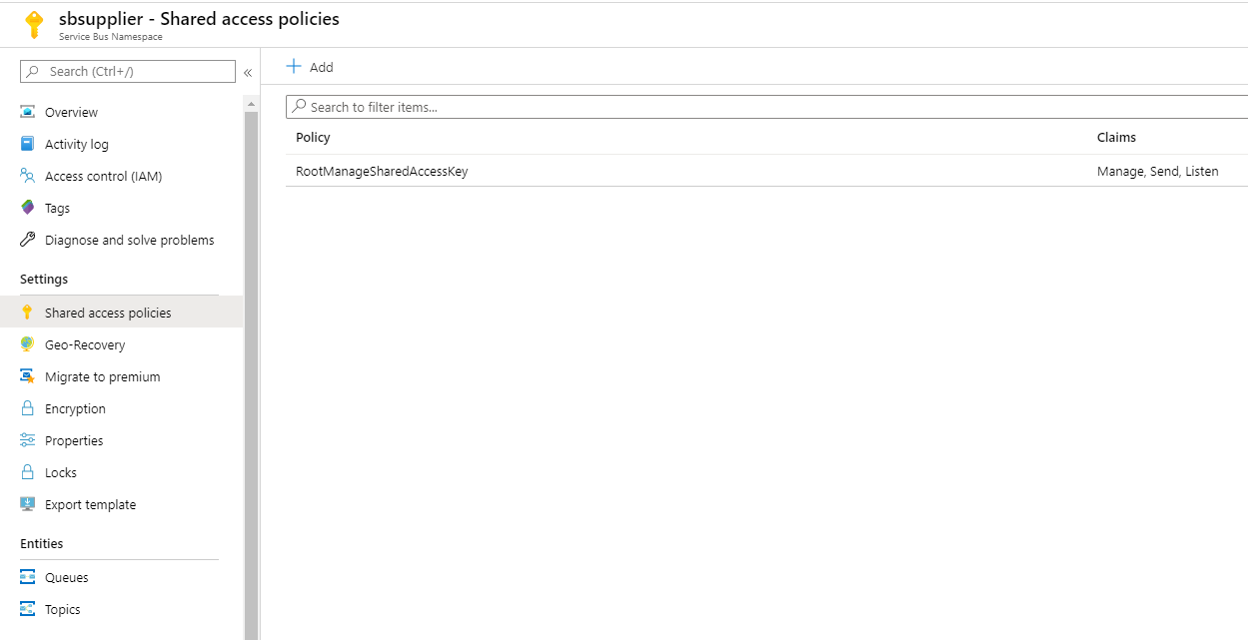
You can connect to your service bus by navigating to the portal in your browser, enter your Service Bus Resource, navigate to share access policies and press the default policy. Copy the connectionstring from the right menu and enter that string into the “Connection String” box in your SBE and press ok.

Slide 4
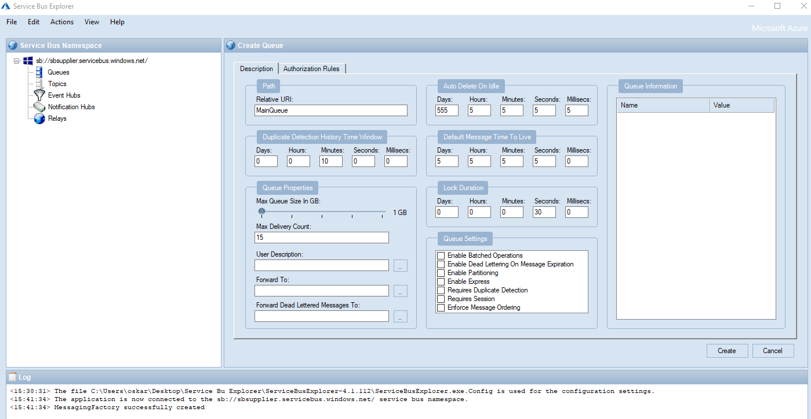
You are now able to manager your service bus from the SBE. Start off by creating a queue by right clicking Queues and select create queue. In this window you can create a queue with configurations unmanageable from the portal. If you’re unfamiliar with these configurations, refer to the Microsoft doc. Especially when configuring “Queue settings” .

Slide 5
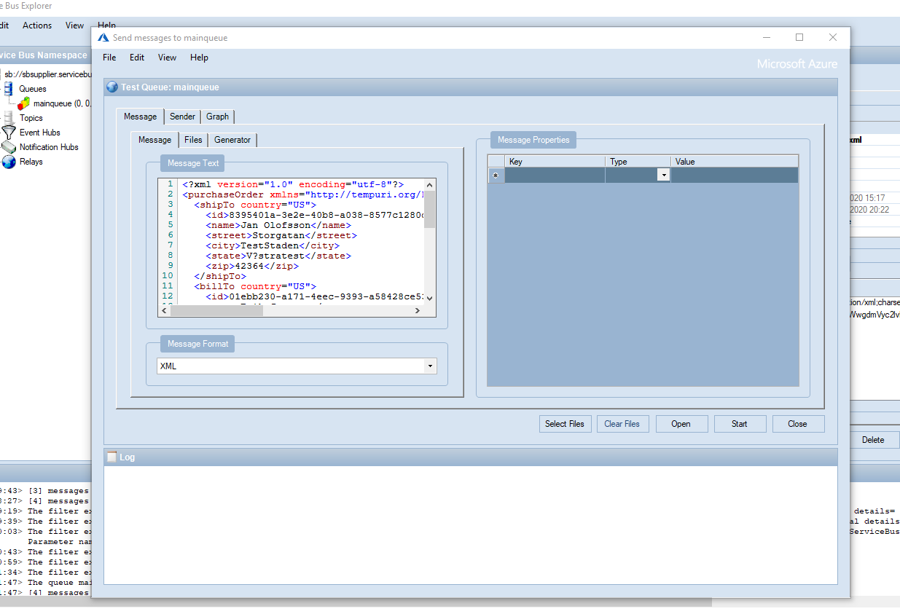
You can now try you sending messages to your queue from inside the SBE by right clicking your new queue and press “message”. This can be really useful to test and debug your service bus queues, topic subscriptions and filters.

Slide 6
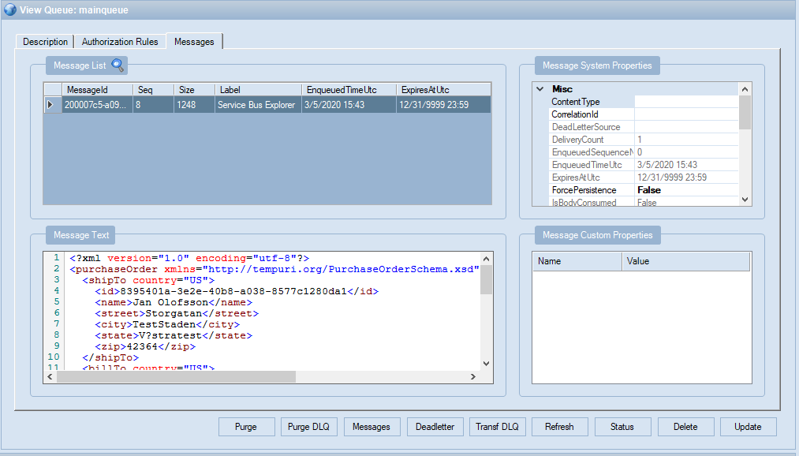
Enter your queue, press “messages” and select “peek” to look at the message you sent. Here you can select a message to take a look at the payload and the message metadata. Some metadata has been generated by default, in accordance to your queue configurations and settings.

Slide 7
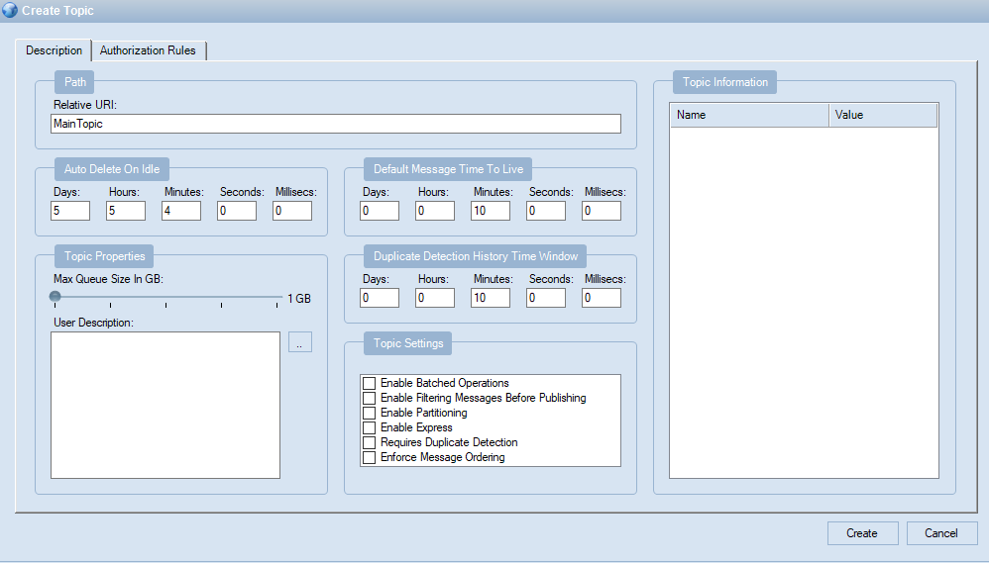
Try to create a topic from your SBE by right clicking “topics” and select create topic, you will find some settings that differs from a queue. Explore these using the Microsoft docs. When you are done press create.

Slide 8
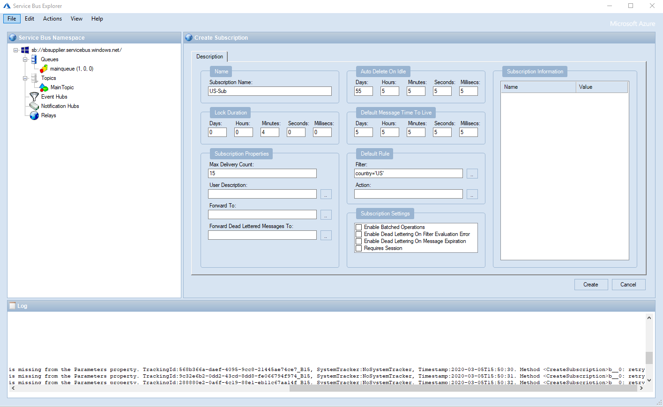
To create a subscription to your Topic, right click “topic” and select add subscription. Create a subscription and read the Microsoft documentation to consider your settings and configurations. You can create your subscription with a default filter, allowing only messages that for fill that criteria to pass to the subscription. In this case we will split messages on a country property assigned in the meta data at a custom property, not the actual content payload. Create an additional subscription with the filter “country=FR”.

Slide 9
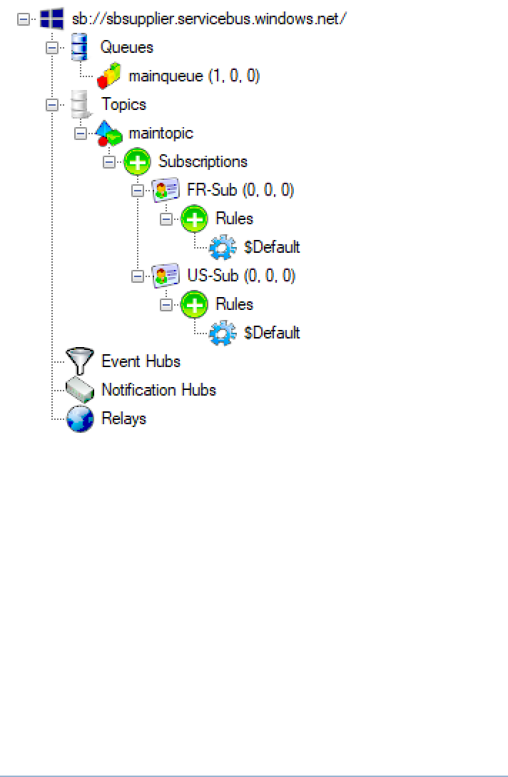
Your Topic, Subscriptions and filters should look something like this. The current filters use xpath syntax which can include a number of logical operation and properties to base your filtering on. You can add additional filter files to your subscription and refer to them inside your $Default file.

Slide 10
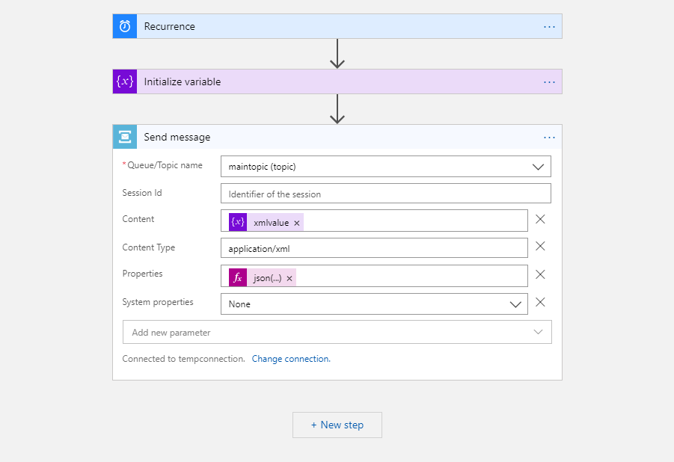
Create a new logic app according to the picture, make a variable with a xml or json format and supply that in the “Content” parameter of you service bus action. Add keyvalue pairs to the “Properties” parameter to provide your message with the data to filter your message across subscriptions. Run your logic app to send a message to your topic. You can also send messages to your topic in SBE.

Slide 11
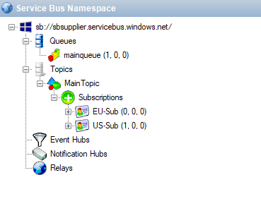
Open your SBE and check the topic subscriptions. As you can see, the message has been filtered on the assigned valuepair property. Read the message in the subscription which filters the sent value, to verify the value of the property assigned in the logic app.

